Slide 1
4.2 Reflections

Slide 2
Warm-up
You need a piece of graph paper, a reflective device and graph triangle A(1, 2) B(3, 7) C(4, 4).
Use a ruler to draw a line that does not pass through the triangle. Label it m.
Place a reflective device on m.
Use the reflective device to plot the images of the vertices A B and C. Connect the vertices to complete your image.

Slide 3
Reflection
A transformation that uses a line like a mirror to reflect a figure.
The mirror line is called the line of reflection.

Slide 4
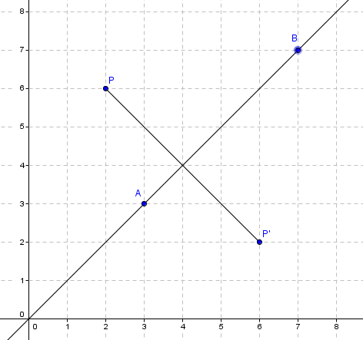
A reflection in a line $\overset{⃡}{AB}$ maps every point P in the plane to a point P’ such that
If P is not on $\overset{⃡}{AB}$, then $\overset{⃡}{AB}$ is the perpendicular bisector of PP’.
If P is on $\overset{⃡}{AB}$, then P = P’.

Slide 5
Graph triangle D(1,3) E(5,2) and C(2,1) and its image over the line a) x = 3 and b) y = 1.

Slide 6
Now reflect F(-1,2) G(1, 2) over the line y = x.
Then reflect over the line y = -x.

Slide 7
Coordinate Rules for Reflection
If (a, b) is reflected over the:
x-axis, the image is (a, -b)
y-axis, the image is (-a, b)
line y = x, the image is (b, a)
line y = -x, the image is (-b, -a)

Slide 8
4.2 Reflection Postulate
A reflection is a rigid motion.

Slide 9
Glide Reflection
When you translate a figure, then reflect it.
It is a rigid motion. Why?
EX: Graph R(3,2) H(6,3) S(7,1) and its image after the glide reflection
Translation: (x,y) -> (x-5,y+1)
Reflection: in the x-axis.

Slide 10
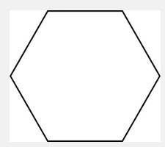
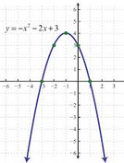
Line Symmetry
A figure has line symmetry when the figure can be mapped onto itself by a reflection in a line. That line is called a line of symmetry.

