Slide 1
12.2 Volume

Slide 2
Volume Definition
The measure of the amount of space contained in a solid
Volume is measured in CUBIC units

Slide 5
Cylinders
Like prisms, but have a circular base.
Still area of base x height, except now area of base is a circle so…
V = $πr^{2}$h

Slide 6
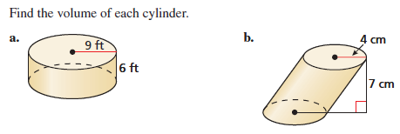

Slide 7
Examples
Find the volume of a pentagonal prism with each side of the pentagon having the length of 14” and the prism height of 8”.

Slide 8
This video won the award for “Worst Choice of Food Coloring in a Geometry Demonstration” in 2008

Slide 9
Solid | Formula
Volume of Pyramid | V = 1/3 Area of Base x height
Volume of Right Circular Cone | V = 1/3Area of Base x Height V = 1/3 r²h

Slide 10
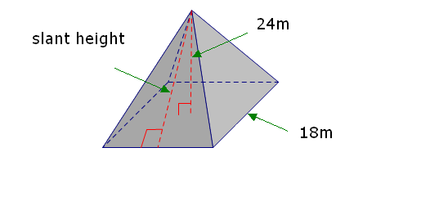
Examples
Find the volume of the square pyramid.

Slide 11
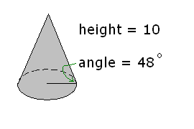
Examples
Find the volume of the cone.

