Slide 1
9.5 The Tangent Ratio

Slide 2
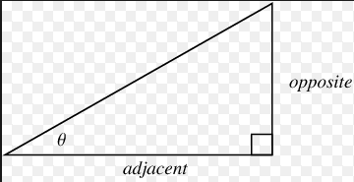
In a right triangle, the tangent of an acute angle is the ratio of the length of the opposite leg divided by the length of the adjacent leg.
(YOU CANNOT TAKE THE TAN OF THE 90^{O} ANGLE)

Slide 3
Go to scevmath.org and open up the tangent.ggb geogebra file.
Use the length tool to find the lengths of the opposite legs and adjacent legs.
Find the tangent of 30 degrees (tan 30) for each right triangle.
What is the relationship between the right triangles?
What is the relationship between the tan 30 for each triangle?

Slide 4
Construct a 30-60-90 right triangle and find the tan 30. How does this compare to your results from the geogebra investigation?
Also, find the tan 60 using the same triangle.

Slide 5
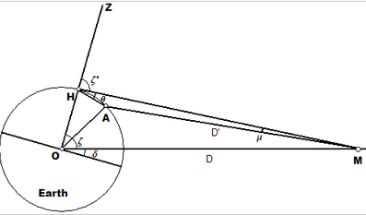
Hipparchus is credited with constructing the first trig tables.
He is credited with the oldest surviving work that accurately modeled the path of the moon and sun.

Slide 6
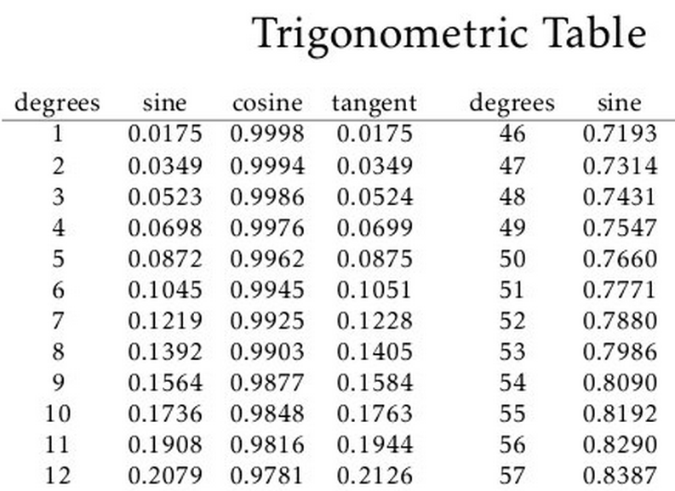
What’s a trig table?

Slide 7
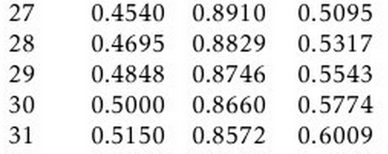

Slide 8
What is the tan 45 ?

Slide 9
Most calculators are pre-programmed with a trigonometric table.
Take out your calculator AND/OR your smartphone.
Listen as I discuss how each calculator works since they all work a little differently.

Slide 10
Guided Practice
Challenge: Use a trigonometric table to find the measure of each angle.

Slide 11
Use tan to find x.

Slide 12
Use tan to find the measure of angle S.

