Slide 1
9.4 Similar Right Triangles

Slide 2
Geometric Mean
The arithmetic mean of a and b is $\frac{a+b}{2}$
The geometric mean of a and b is x where $\frac{a}{x}=\frac{x}{b} or x=\sqrt{ab}$

Slide 3
On your desk
Draw a large right triangle.
Construct an altitude from the right angle.
Write three similarity statements.

Slide 5
Guided Practice

Slide 6
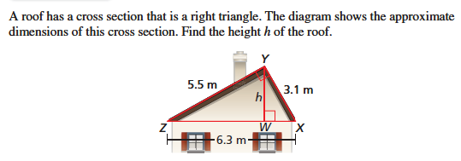
Hint: Draw out the three triangles separately.

Slide 7
Guided Practice

