Slide 1
8.2 Similar Triangles

Slide 2
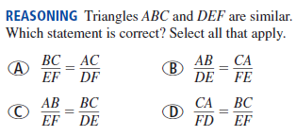
Warm-up

Slide 3
Similar Polygons
What are two characteristics of similar polygons?
Specifically, how can we prove two triangles are similar?

Slide 4
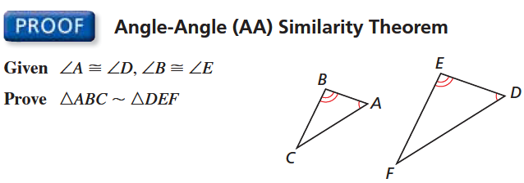

Slide 5
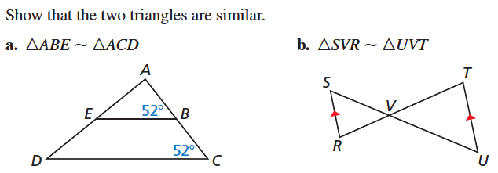
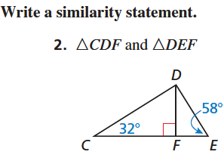

Slide 6
