Slide 1
7.5 Trapezoids and Kites

Slide 2
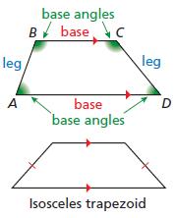
Trapezoids
Definition- A quadrilateral with exactly one pair of parallel sides.
Bases – Parallel sides
Legs – Non-parallel sides
Isosceles Trapezoid – Legs are congruent.

Slide 3
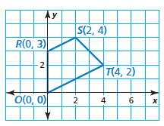
Identify the quadrilateral

Slide 4
Trap Theorems
Isosceles Trapezoid Base Angles Theorem
If trapezoid is isosceles, then each pair of base angles is congruent.
Isosceles Trapezoid Base Angles Converse
If a trapezoid has a pair of congruent base angles, then it is isosceles.
Isosceles Trapezoid Diagonals Theorem
A trapezoid is isosceles if and only if the diagonals are congruent.

Slide 5
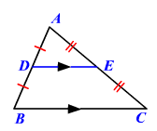
Midsegment of a Triangle
What were the two properties?

Slide 6
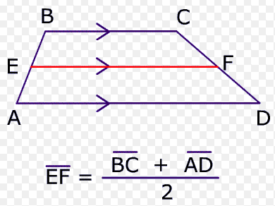
Midsegment of a Trapezoid
The length of the midsegment is equal to the average of the lengths of the bases.
The midsegment is parallel to the bases.

Slide 7
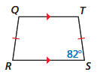
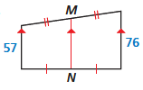
Guided Practice
Find the measure of each angle in trapezoid QTSR
Find the length of MN.
Find the length of AB.

Slide 8
Kites
Definition: Two pairs of consecutive congruent sides, but opposite sides are not congruent.

Slide 9
Theorem: Diagonals are perpendicular.
Theorem: Exactly one pair of opposite angles
are congruent.

Slide 10
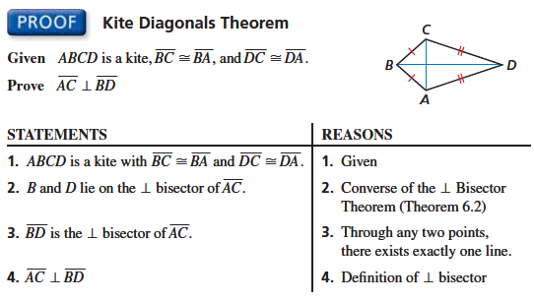

Slide 11
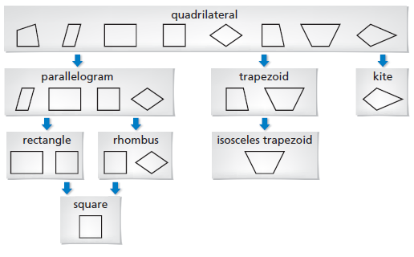

Slide 12
Guided Practice

