Slide 1
7.2 The Ambiguous Case

Slide 2
What does “ambiguous” mean?

Slide 3
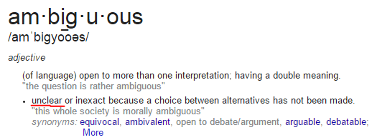
What does “ambiguous” mean?

Slide 4
What were the triangle congruence shortcuts from geometry to prove two triangles were congruent?

Slide 5
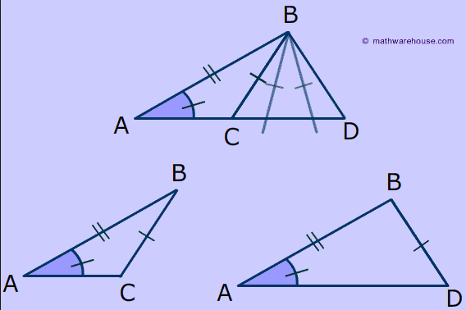
ASS – The Ambiguous Case

Slide 6
Ambiguous Case Flow Chart

