Slide 1
5.1 Angles of Polygons

Slide 2
Sum of interior angles of an n-gon:
(n-2)180 degrees
Each interior angle of a regular n-gon:
(n-2)180/n degrees
Sum of exterior angles of an n-gon:
360 degrees
Each exterior angle of a regular n-gon:
360/n degrees

Slide 3
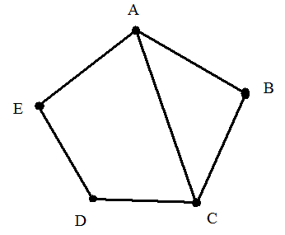
Consecutive Vertices: endpoints of the same side.
Diagonals: segment connecting two
non-consecutive vertices.
Convex – Every diagonal constructed is inside the polygon.
Concave – There can be a diagonal constructed outside the polygon.

Slide 4
Equilateral Polygons – All sides
are congruent.
Equiangular Polygons – All angles
are congruent.
Regular Polygon – Equilateral and equiangular.

Slide 5
Find the measure of each interior and exterior angle of a regular dodecagon.

Slide 6
https://app.peardeck.com/editor/0BzkYTpvUAbqjN0t4RlpoWGdzck0/slides/freeResponse-text/wkDEL1T3b3g3

Slide 7
Exit Ticket
Find the measure of each interior angle of a 20-gon.

