Slide 1
Objective: For students to use the half angle formula to find sin(22.5) without a calculator
Standards: F-TF 8
HW: P. 266, 1, 2, 5, 6, 7, 9, 11, 15, 17, 19, 21, 23, 25, 31, 33, 41, 49, 51
Assessment: Exit Ticket

Slide 2
Warm-up
Given secA = -17/15 in QIII and tanB = 11/60 in QI. Find sin(A+B), cos(A-B) and tan(2A).
Evaluate:
sin(π/15)cos(π/10) + cos(π/15)sin(π/10)
Prove sinB/tanB =

Slide 3
5.4 Half Angle Formulas

Slide 4
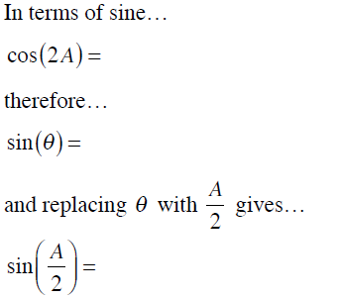

Slide 5
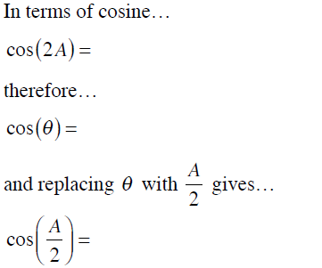

Slide 7
Evaluate without a calculator
cos(105)
sin(195)
sin(22.5)
cos(15)
sin(67.5)

Slide 8
Homework
P. 266, 1, 11, 17, 19, 21, 31, 51

