Slide 1
Pre-Calc/Trigonometry, 5.3 Sum/Difference and Double Angle Formulas for Tangent
Objective: For students
Standards: F-TF 8
HW: p. 252, 3, 4, 17, 18, 39, 45
Assessment: Observe understanding during guided practice

Slide 2
5.3 Sum and Difference Formulas
Tangent

Slide 3
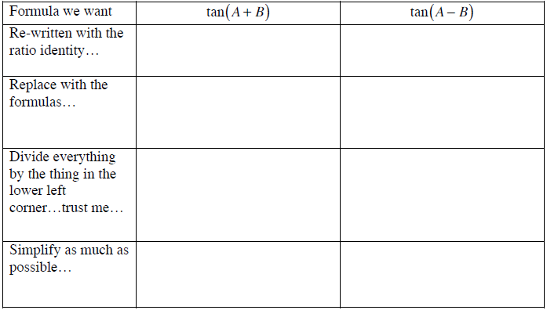

Slide 4
Double Angle Formula for Tangent

Slide 5
Formula Recap

Slide 6
Practice Problems
Evaluate: 1. tan(π/12) 2. tan(255º)
Graph: 3. y = 3sin(x)cos(2x) + 3cos(x)sin(2x)
4. Given: SinA = 3/5 in QII, cotB = 20/21 in QIII. Find sin(2A), cos(A+B) and tan(A-B).
Evaluate:
5. 2tan(15)/(1 – tan²(15)
6. (tan140 – tan15)/(1+tan15tan140)

Slide 7
HW: p. 252, 3, 4, 17, 18, 39, 45

