Slide 1
Pre-Calc/Trigonometry, 5.2 Sum/Difference and Double Angle Formulas for Sine and Cosine
Objective: Student will be able to evaluate the sin(105) without a calculator.
Standards: F-TF 8
HW: #1 study# p.260 5, 7, 13, 15, 21, 25, 27, 31, 35, 43
Assessment: Observe understanding during guided practice/Collect HW

Slide 2
5.2 Sum and Difference Formulas
For Sine and Cosine

Slide 3
Let’s look for shortcuts
Does sin(A+B) = sinA + sinB?

Slide 4
Investigation of the Sum and Difference Formulas

Slide 5
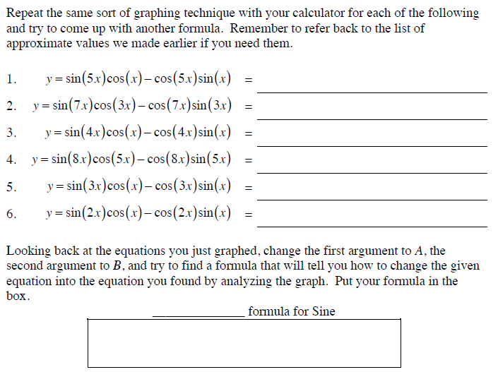

Slide 6
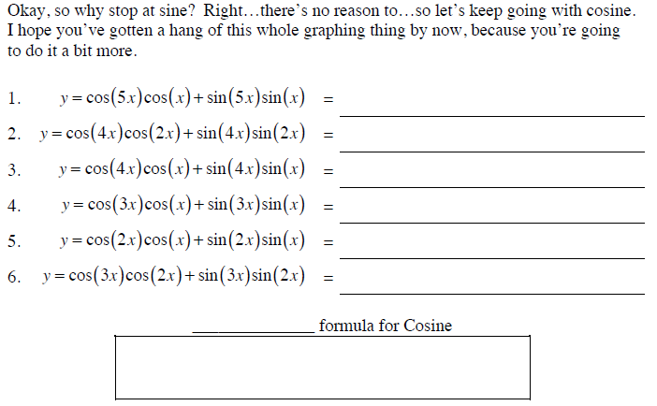

Slide 7
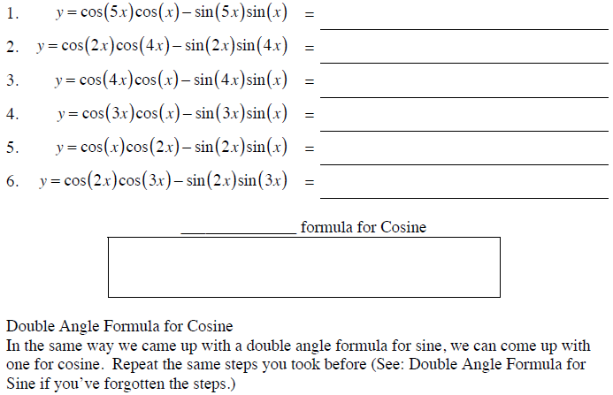

Slide 8
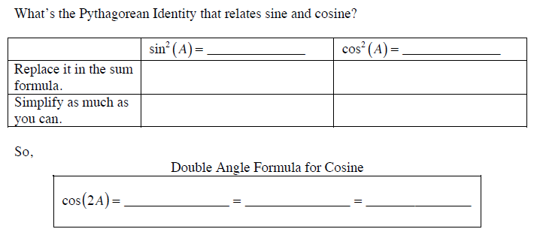
Double Angle Formula for Cosine

Slide 9
We now have 8 formulas, lets review…

Slide 10
5.2 Practice Problems
HW: Finish and study for your quiz on identities.

Slide 11
HW – After Quiz
p.260 5, 7, 13, 15, 21, 25, 27, 31, 35, 43

