Slide 1
Objective: For students to learn how to prove identities.
Standards: F-TF 8
HW: Worksheet 5.1 Proving Identities, Textbook section 5.1 problems
Assessment: Observe understanding during guided practice

Slide 2
5.1 Identities

Slide 3
Warm-up

Slide 4
Identity
An equation that is true for all its x values is called an identity.
The equations in the warm-up are called identities.

Slide 5
Why do we need to learn identities in trigonometry?
They make things simpler.

Slide 6
In order to show an equation is an identity, we need to prove it. We will be practicing that a lot for the next few class periods.

Slide 7
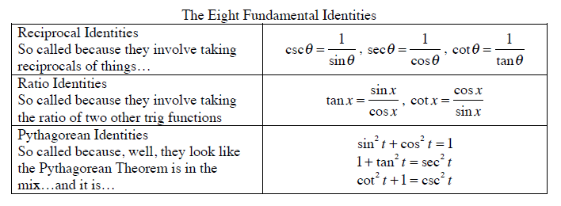
Let’s start with these…

Slide 8
Reciprocal Identities
True by definition

Slide 9
Ratio Identities
Use the right triangle definitions of sine and cosine to show that tan(x) = sin(x)/cos(x) and that cot(x) = cos(x)/sin(x)

Slide 10
Pythagorean Identities
Again, use right triangle definitions to show that sin²(x) + cos² (x) = 1

Slide 11
Now let’s prove the other two Pythagorean identities.

Slide 12
The 10 Commandments of Identities

Slide 13
#1 Memorize the 8 Fundamental Identities.

Slide 14
#2 NEVER CROSS AN EQUAL SIGN!!
Prove: tan(x)csc(x) = sec(x)

Slide 15
#3 Try breaking up fractions with sum or differences in the numerator
Period 6 stopped here

Slide 16
#4 Usually better to start on the more complicated side

Slide 17
#5 Try adding and subtracting fractions by getting a common denominator

Slide 18
#5 Try adding and subtracting fractions by getting a common denominator
Per 3 ended here after day 2

Slide 19
#6 If you can distribute something, try

Slide 20
#6 If you can distribute something, try

Slide 21
#7 Try factoring

Slide 22
#7 Try factoring

Slide 23
#8 Try multiplying by a form of 1

Slide 24
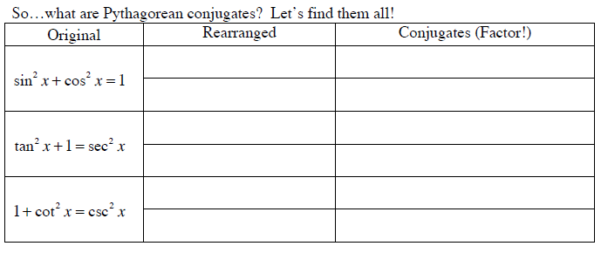
#8 Try multiplying by a form of 1 (Pythagorean Conjugates)

Slide 25
#8 Try multiplying by a form of 1

Slide 26
#8 Try multiplying by a form of 1

Slide 27
#9 Last resort, convert everything to sines and cosines.

Slide 28
#9 Last resort, convert everything to sines and cosines.

Slide 29
#10 - It is perfectly okay to give up at any point and start again with a new approach.

Slide 30
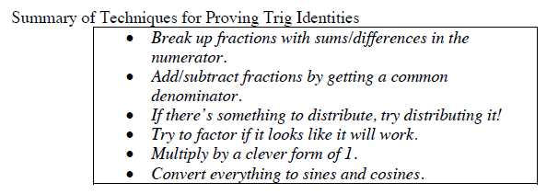

Slide 31
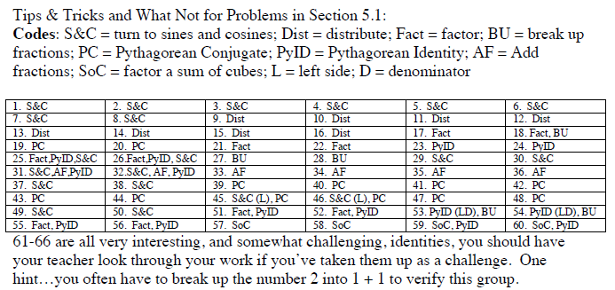

Slide 32
HW
P. 243: 9, 13, 17, 21, 25, 29, 33, 37

