Slide 1
Warm-up
Graph the following and find the amplitude, period, increment, S.A., starting point, domain and range.
Y = -2sin(2x + 4π) – 1

Slide 2
4.4 Tangent and Cotangent

Slide 3
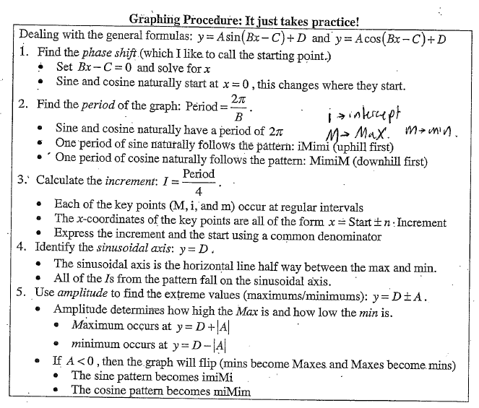

Slide 7
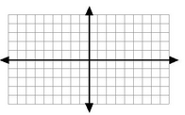

Slide 8
TAN people
Might
Hate
Applying
Lotion

Slide 10
All Hail the Math Letes

Slide 11
Let’s do two together
y = 2tan(2x – π) – 1
y = -2tan(2x – π) – 1

Slide 12
Steps to Graphing Tangent and Cotangent (y=a*tan(bx-c)+d)
1) Find phase shift by setting bx - c = 0 and solving for x.
2) Find period π/b and increment period/4. Mark off starting point and increments on the x-axis.
3) Use d and a to find the Middle point (y = d), High point (y = d +|a|), Low point (y = d - |a|).
4) Plot points using MHAL or AHML depending on if its tangent or cotangent respectively. Vertically flip graph if the leading coefficient a is negative.
5) Connect the points L,M and H with smooth curves and draw vertical dashed lines through A for the asymptotes.

Slide 13
Guided Practice/HW
Graph each trig function and find the amplitude, period, increment, S.A., starting point, domain and range.
y = -3tan(πx - 4 ) + 3
Y = 4tan(πx/4) – 2
Y= -4tan(πx/2 + π/2) + 2
Y =cot(2x)

Slide 14
Guided Practice/HW
Graph each trig function and find the amplitude, period, increment, S.A., starting point, domain and range.
y = -3tan(πx - 4 π) + 3
Y = 4tan(πx/4) – 2
Y= -4tan(πx/2 + π/2) + 2
Y =cot(2x)
Y = 3cot(x – π/2) + 2
Y = -2cot(2x + π) – 3
Y = (-1/2)tan(4x – π) + 1
Y = 3tan(πx + 2 π) - 3

Slide 15
Sine and Cosine Review
Y = 3sin(2x) + 1
Y = 4cos(x/2) + 1
Y = - 3cos(πx - 2π) + 1

