Slide 1
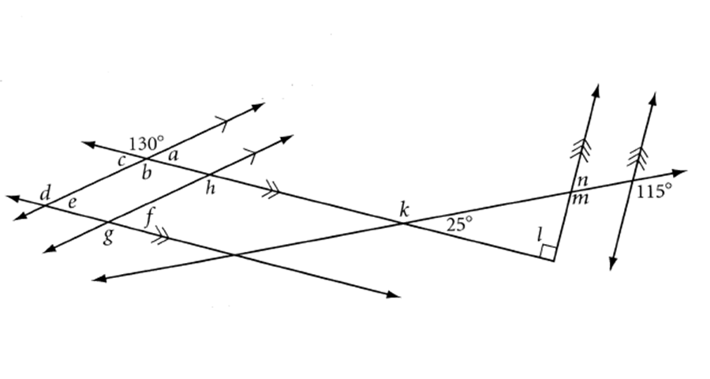
Warm-up

Slide 2
3.3 Parallel Converse and Proofs

Slide 3
If two parallel lines are intersected by a transversal, then alternate interior angles are congruent.
If two parallel lines are intersected by a transversal, then alternate exterior angles are congruent.
If two parallel lines are intersected by a transversal, then corresponding angles are congruent.
If two parallel lines are intersected by a transversal, then consecutive interior angels are supplementary.
Find the converse of each statement.

Slide 4
Investigation – Are the converses true?
Draw 2 intersecting lines on a piece of patty paper with a ruler.
Trace these lines onto another piece of patty paper.
Place the original patty paper over the second patty paper such that it looks like two lines being intersected by a transversal.
Determine whether the two lines are parallel.

Slide 5
Special Angles on Parallel Lines Converse
If two lines intersected by a transversal form angles such that alternate interior angles, alternate exterior or corresponding angles are congruent, then those two lines are parallel.
Also works if consecutive interior angles are supplementary.

Slide 6
145
Are these lines parallel?
35

Slide 7
1. Set two expressions equal if they are vertical angles and add them and set them equal to 180 if they are linear pairs. You should not set up a system (having an equation with two different variables) but rather 2 different equations. 1 with x and 1 with y.
2. Solve for x and y.
3. Plug x and y in to get you angle measures.
4. Compare corresponding angles, alternate interior/exterior angles and see if they are congruent. If so, the lines are parallel. If not, they are not parallel.

Slide 8
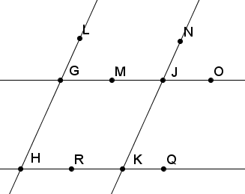
Given: <OJK = 55,
<OJK=<JGH,
<GHR = 125.
Prove: GJ||HK

Slide 9
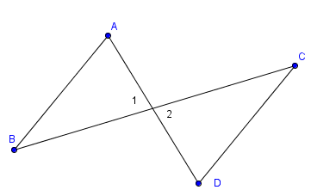
Given: <A = <1, <2 = <D
Prove: AB||CD

