Slide 1
15.3 Permutations and Combinations

Slide 2
Warm-up
Suppose a club with 5 members wishes to choose a president, vice president and treasurer. In how many ways can this be done?

Slide 3
Answer
5x4x3 = $\frac{5!}{2!}$ = 60
The order was important since A, B, C was different from B, A, C (if A, B, C represent people) since in one case one person was the president, but not in the second.

Slide 4
Now suppose a club with 5 members wishes to choose a leadership council of 3 members. How many ways can this be done?

Slide 5
Answer
$\frac{5×4×3}{3×2×1}= \frac{5!}{3!2!}$ = 10
In this case, the order of selection is not important because ABC is the same as BAC but different from DAB since all three of those people have equal positions. For each governing council of 3 that can be chosen (say ABC), there are 3! Different slates of officers (ABC, ACB, BAC, BCA, CAB, CBA).

Slide 6
In the first situation, where order matters, each selection is called a permutation of 3 people from a set of 5.
In the second situation, where order is not important, each selection is called a combination of 3 people from a set of 5.

Slide 7
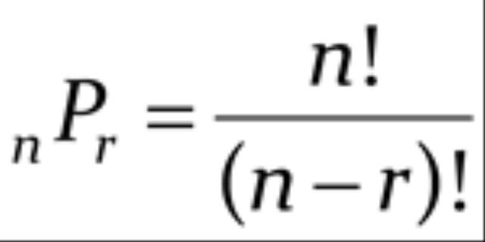
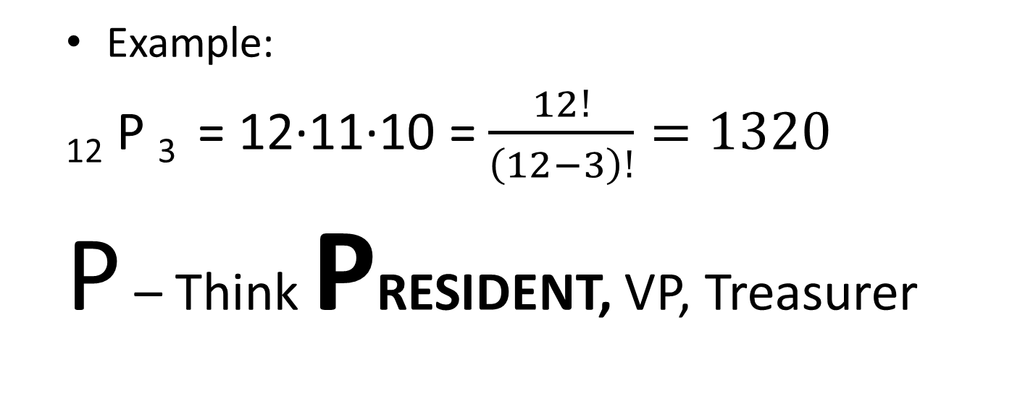
Permutation
Order matters
= n(n-1)…(n - r + 1)
Example:
₁₂ P ₃ = 12∙11∙10 = $\frac{12!}{\left(12−3\right)!}=1320$
P – Think PRESIDENT, VP, Treasurer

Slide 8
Combination
Order does not matter
_{n} C _{k} =
Example
₁₂ C ₃ = $\frac{12!}{\left(12−3\right)!3!}= \frac{12∙11∙10}{1∙2∙3}$ = 220
C – Think Committee or Council

Slide 9
A company advertises two job openings, one for a copywriter and one for an artist. If 10 people who are qualified for either position apply, in how many ways can the openings be filled?

Slide 10
A company advertises two job openings for computer programmers, both with the same salary and job description. In how many ways can the openings be filled if 10 people apply?

Slide 11
For a certain raffle, 845 tickets are sold.
a) In how many ways can four $50 gift certificates be awarded?
b) In how many ways can a $100, a $50, a $20, and a $10 gift certificate be awarded?

Slide 12
At a Diner, an omelet can be ordered plain or with any or all of the following fillings: cheese, onions, peppers. How many different kinds of omelets are possible?

Slide 13
A standard deck of cards has 52 cards, 13 cards per suit, 2 colors and 3 face cards per suit. How many ways can 13 cards be dealt from a standard deck if the order is important? Is not important?

Slide 14
Permutation or Combination
Write a big P or C on your whiteboard with your partner depending on whether the situation is a Permutation or a Combination.

Slide 15
1. Selecting three toppings for ice cream

Slide 16
Selecting the starting players for a basketball game.

Slide 17
3. Selecting three students to call on for answers.

Slide 18
4. Ranking your two favorite musical groups.

Slide 19
5. Selecting four toppings for a hot dog.

Slide 20
6. Selecting four ingredients for a soup.

Slide 21
7. Selecting three officers for a club.

Slide 22
8. Selecting three operations to be used to solve.

Slide 23
9. Selecting three students to speak at graduation.

