Slide 1
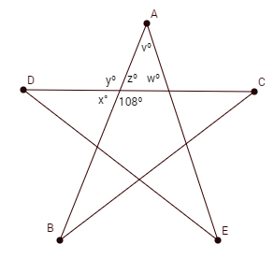
Warm-up
What do you notice about the following pairs of angles? 1) x & y 2) y & z 3) x & z
Also, find the missing angles.

Slide 2
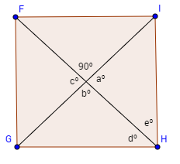
Find the missing angle measures.

Slide 3
1.6 Describing Pairs of Angles

Slide 4
Vocab
Complementary Angles
Supplementary Angles
Adjacent Angles
Vertical Angles
Linear Pair

Slide 5
FPQ!!!

Slide 6
P. 51 diagram

Slide 7
