Slide 1
1.5 Measuring and Constructing Angles

Slide 2
Angle – two rays that have the same endpoint.
What do we call the endpoint? ___________
What do we call the rays? ___________
There are three ways to name an angle. Lets practice naming them.

Slide 3
How to Construct Congruent Angles
P. 40 big ideas textbook. Do not label your angles.
Congruent Angles – Angles with the same measure.

Slide 4
Take the congruent angles you just constructed and pass it to someone else. Now label your new angle.

Slide 5
Now take that angle and switch it with someone else. Name your new angle three different ways.

Slide 6
Take the angle and switch it with someone else. Measure the angle.

Slide 7
Take your angle and switch it with some one else. Bisect that angle.

Slide 8
Take your angle and switch it with someone else. Write a congruency statement for the two angles.

Slide 9
How to bisect an angle with a compass.
P. 42

Slide 10
Angle Addition Postulate
If P is in the interior of RST, then the measure of RST is equal to the sum of the measures of RSP and PST.
p. 41

Slide 11
Vocab
Acute Angle
Obtuse Angle
Right Angle
Straight Angle

Slide 12
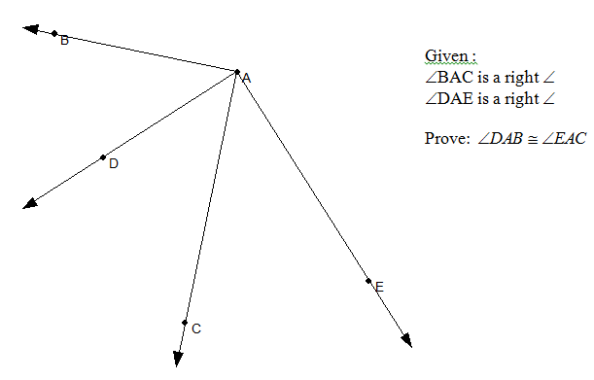

Slide 14
Guided Practice
1.5 Practice Problems

